Slide 1
Adding Robustness to HYDRA
Handling unseen queries
By Kapil Khurana & Vishal Goel
09/12/2018

Slide 2

Introduction
Synthetic data to test vendor’s database engine on
AQPs from client

Slide 3
Introduction
Synthetic data to test vendor’s database engine on
AQPs from client
HYDRA works well only on AQPs similar to the ones in the input.

Slide 4
Introduction
Synthetic data to test vendor’s database engine on
AQPs from client
HYDRA works well only on AQPs similar to the ones in the input.
Basically HYDRA is not smart (yet!)

Slide 5


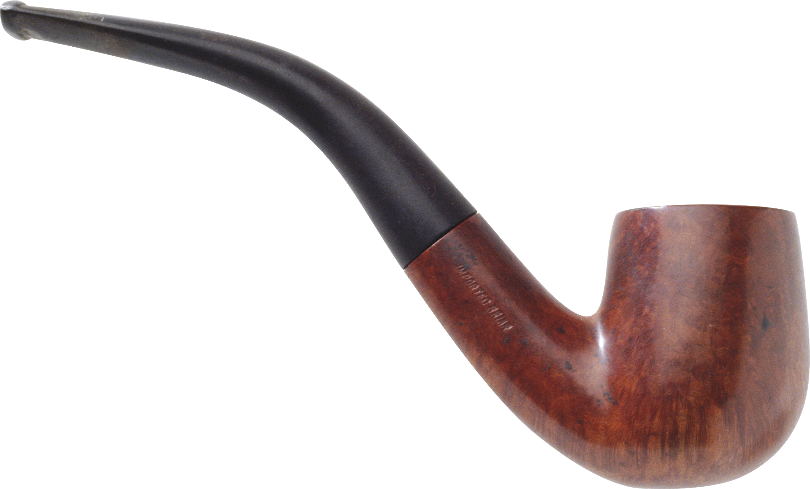
Problem Statement
To implement a learning based cardinality estimation model and integrate it into HYDRA

Slide 6
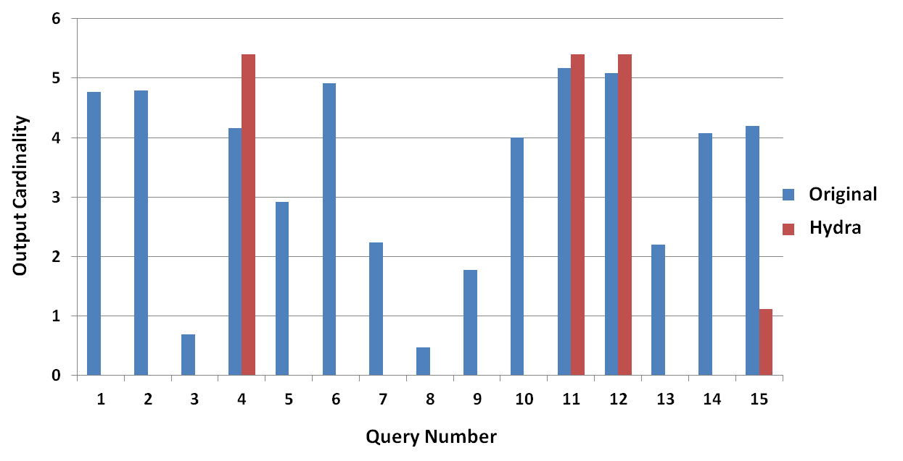
Performance on unseen queries

Slide 7
Shortcomings in HYDRA
Why HYDRA performed poorly on unseen queries?

Slide 8
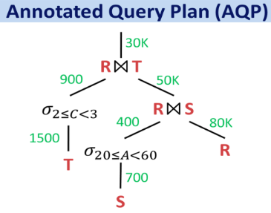
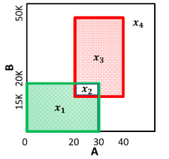
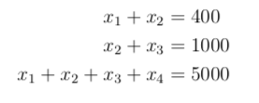
Inconsistent Inter-Region Data Distribution

Slide 9

Inconsistent Inter-Region Data Distribution
Multiple possible solutions. Is any arbitrary solution consistent with original database?

Slide 10
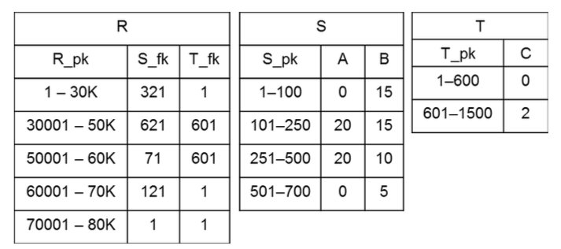
Inconsistent Intra-Region Data Distribution
Example Database Summary

Slide 11
Inconsistent Intra-Region Data Distribution
This looks so made up! Surely, actual data distribution must be very different!
Example Database Summary

Slide 12
Inter-Region Data Distribution achieved
+
Intra-Region Data Distribution achieved
=
Unseen Queries satisfied much better than HYDRA
Achieving Intra-Region DD
fixes cardinality here
x1
x2
x3
x4
Unseen Query
Achieving Inter-Region DD fixes cardinality here

Slide 13
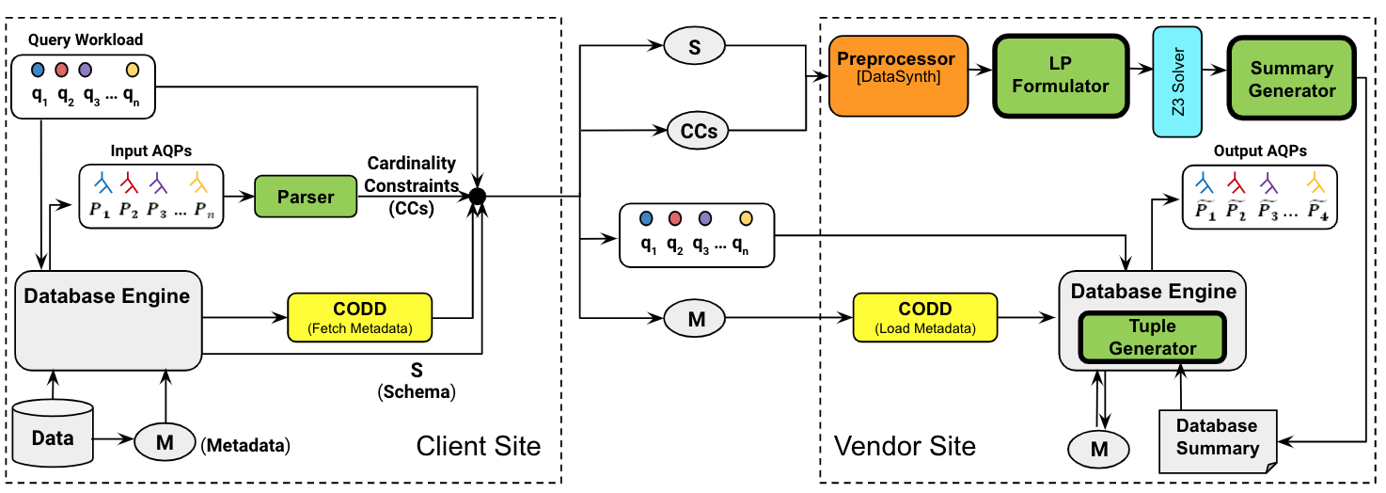
Current HYDRA Architecture

Slide 14
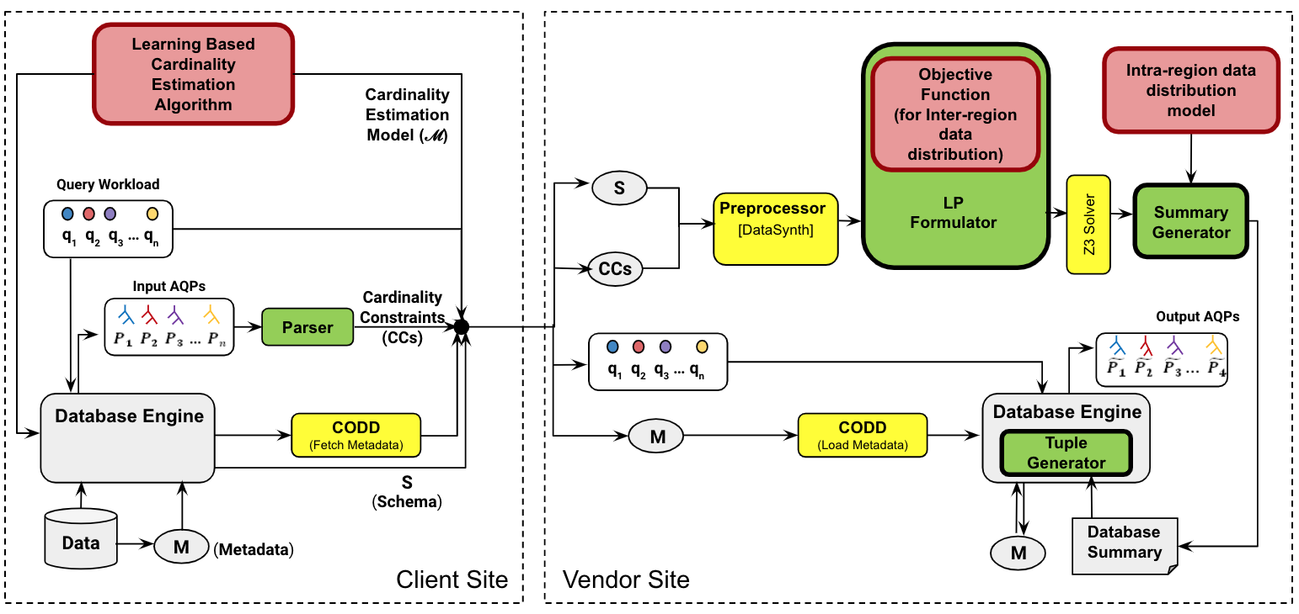
Smart - HYDRA Architecture

Slide 15
Are new modules compatible with HYDRA?
Cardinality Estimation Module
Inter-Region Data Distribution Module (Not compatible with z3 solver)
Intra-Region Data Distribution Module

Slide 16
Phase 1 :
Learning Based Cardinality Estimation
Reference Paper: Learning State Representations for Query Optimization with Deep Reinforcement learning, Jennifer Ortiz, Magdalena Balazinska, Johannes Gehrke, S. Sathiya Keerthi DEEM’18: International Workshop on Data Management for End-to-End Machine Learning, June 15, 2018.

Slide 17
The Neural Network Approach to Cardinality Estimation
1 input layer, 1 hidden layer, 1 output layer
Input Layer : Two nodes for each attribute (one for <= and one for >=)
(a,b) ≣ [a+1, <=b-1] >a ≣ [a+1, attr_max_val]
<b ≣ [attr_min_val, b-1] =a ≣ [a, a] !=a ≣ total_card - [a,a]
Notes:
Single relation is not a problem because hydra is view based. So, for each view we can learn our model. For subviews, we just query the base model for the view. To maintain referential integrity, we’ll talk about in intra

Slide 18
The Neural Network Approach to Cardinality Estimation
Only AND operations among predicates.
To handle OR, we can use DeMorgan’s Law.
To handle NOT, we can compute complement.
Note : Currently, only filter predicates on a single table considered.
Integral domains are assumed for each attribute.
For join predicates, the neural network can be made multi-level, essentially capturing inter-table correlations.
Notes:
Single relation is not a problem because hydra is view based. So, for each view we can learn our model. For subviews, we just query the base model for the view. To maintain referential integrity, we’ll talk about in intra

Slide 19
Neural Network Architecture
A
<=
A
>=
B
<=
B
>=
Output layer
Input Layer
Hidden layer

Slide 20
The Neural Network Approach to Cardinality Estimation
Training Data
DATABASE : IMDB dataset
Table: aka_title
Number of Queries : We took a training size of 20k queries having selection predicates on four attributes (id, kind id, movie id, production year) having operators <= and >= only. 70% of the queries are used for training the model and the rest are used for testing.
Notes:
Why JOB? - because of paper

Slide 21
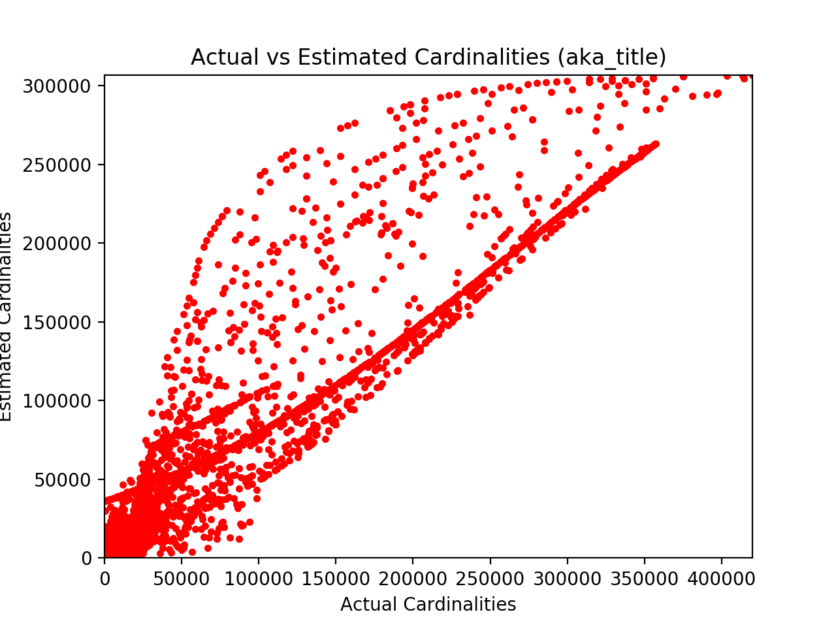
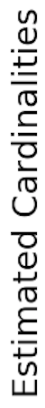
Results

Slide 22
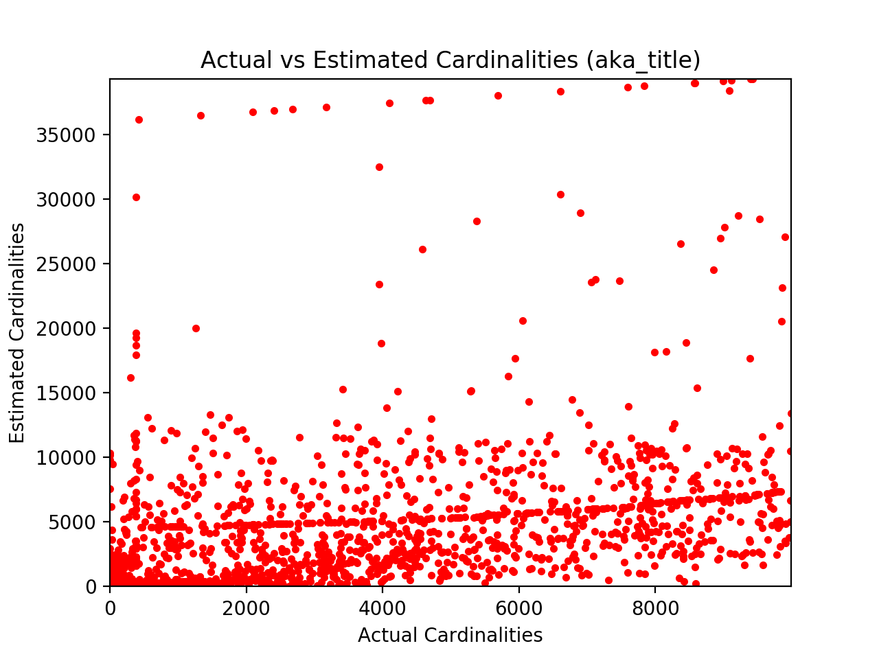
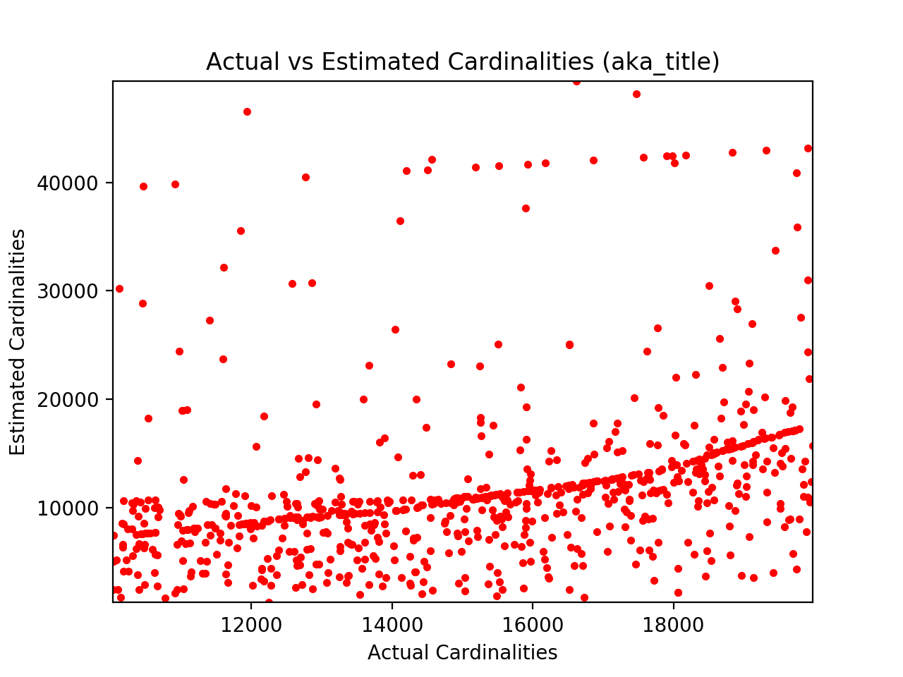

Slide 23
Smart - HYDRA Architecture
Notes:
Treating model as blackbox

Slide 24
Phase 2 :
Handling Inter-Region Data Distribution

Slide 25
Handling Inter-Region Data Distribution

Slide 26
Handling Inter-Region Data Distribution
q(x):query corresponding to region x
Notes:
Demorgan’s law

Slide 27
Handling Inter-Region Data Distribution
Cardinality Estimation Model
q(x):query corresponding to region x

Slide 28
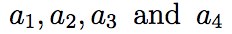
Handling Inter-Region Data Distribution
Cardinality Estimation Model
q(x):query corresponding to region x

Slide 29
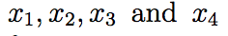
Handling Inter-Region Data Distribution
Cardinality Estimation Model
q(x):query corresponding to region x

Slide 30

Handling Inter-Region Data Distribution
Cardinality Estimation Model
q(x):query corresponding to region x
Objective function
Notes:
Advantages : 0 cardinality regions in each interval will reduce
Incremental workload handling

Slide 31
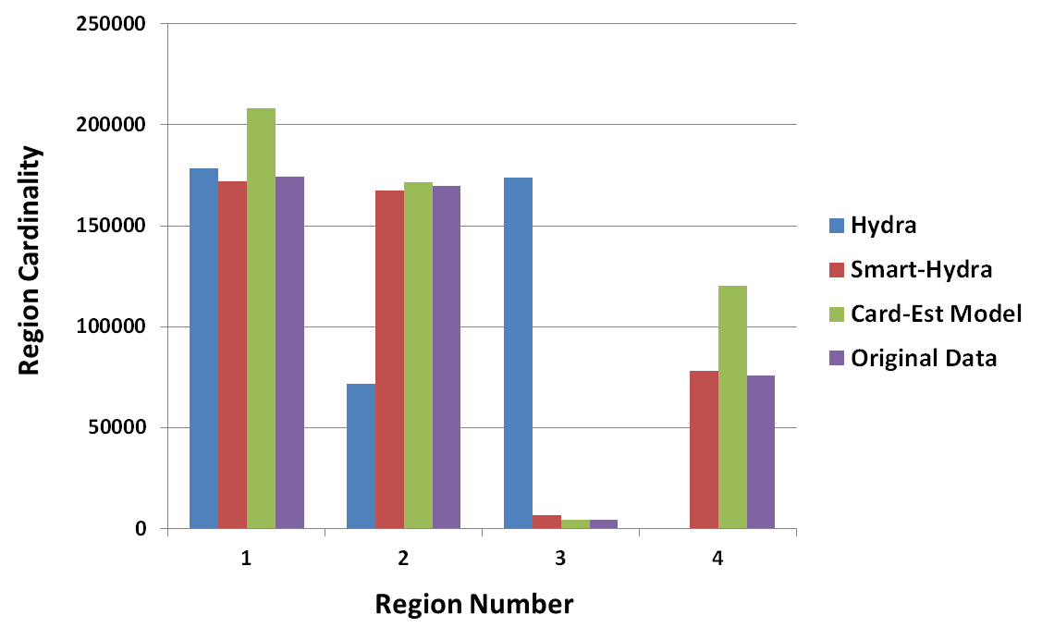
Notes:
Experiments
Problem with z3

Slide 32
Smart - HYDRA Architecture

Slide 33
Phase 3:
Handling Intra-Region Data Distribution

Slide 34
Summary Generation
For each interval for an attribute X in each region, we will first fit an invertible function 𝐹 to the Cumulative Density Function (CDF) we get from our model.
We store the sets of inverse functions 𝐹 ⁻¹ (one for each attribute) corresponding to each region along with the database summary.
We remain in the dataless world.
Notes:
Still in dataless world, storing only functions
Explanation with example

Slide 35
Tuple Generation
Say there exists an x-dimensional region for which we have to generate k tuples.
Now, we will generate k random sample points from a uniform [0,1] - x dimensional distribution.
For each sample point (u₁, u₂, ..., uₓ), we compute the following tuple ((𝐹 ⁻¹ (u₁), 𝐹 ⁻¹ (u₂), …., 𝐹 ⁻¹ (uₓ)).
Notes:
Referential integrity

Slide 36

Thank You

